Slide 1
PIZZA SESSION NetScaler nFactor Toolbox
nFactor Authentication Flows

Slide 2
Hi there!
Contact: E-mail: akafedzhiev@cbtw.tech Personal Blog: https://alekaf.com LinkedIn: https://linkedin.com/in/alekaf
Decade’s worth of IT experience.
I’ve been working at CBTW for the last 4 years specializing in Citrix Networking Portfolio.
Familiar with Virtualization & Networking vendors as Citrix, VMware, Cisco, Palo Alto, HPE, CheckPoint.

Slide 3
Guidelines
nFactor Components
AAA vServer
Login Schema Policy + Login Schema Profile (XML)
Authentication Policy + Authentication Action
Next Factor (Authentication Policy Label)
Assigned to a Resource (vServer) via Authentication Profile
Notes:
The simplest way to thing of an nFactor Configuration are its base components and to picture it as a chain.
All these support expressions and priority evaluation.

Slide 4
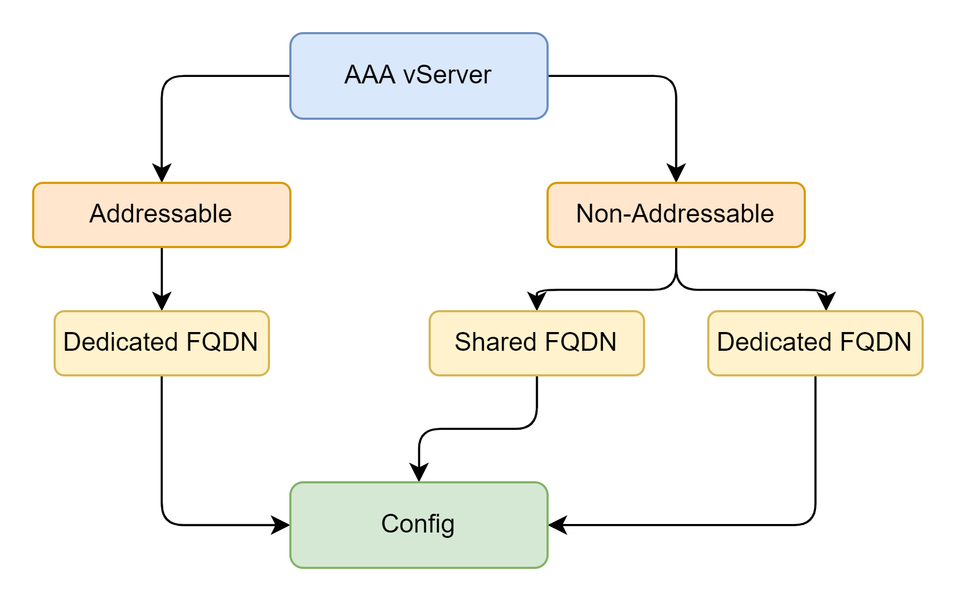
Guidelines
AAA vServer
Consideration
Non-Addressable – Shared Public IP
Addressable – Additional Public IP
Shared FQDN:
App FQDN: SaaS.domain.com
AAA FQDN: SaaS.domain.com
Dedicated FQDN:
App FQDN: SaaS.domain.com
AAA FQDN: login.domain.com
CS Expression: HTTP.REQ.HOSTNAME.SERVER.EQ("SaaS.domain.com" ) && is_vpn_url && HTTP.REQ.URL.EQ("/").NOT

Slide 5
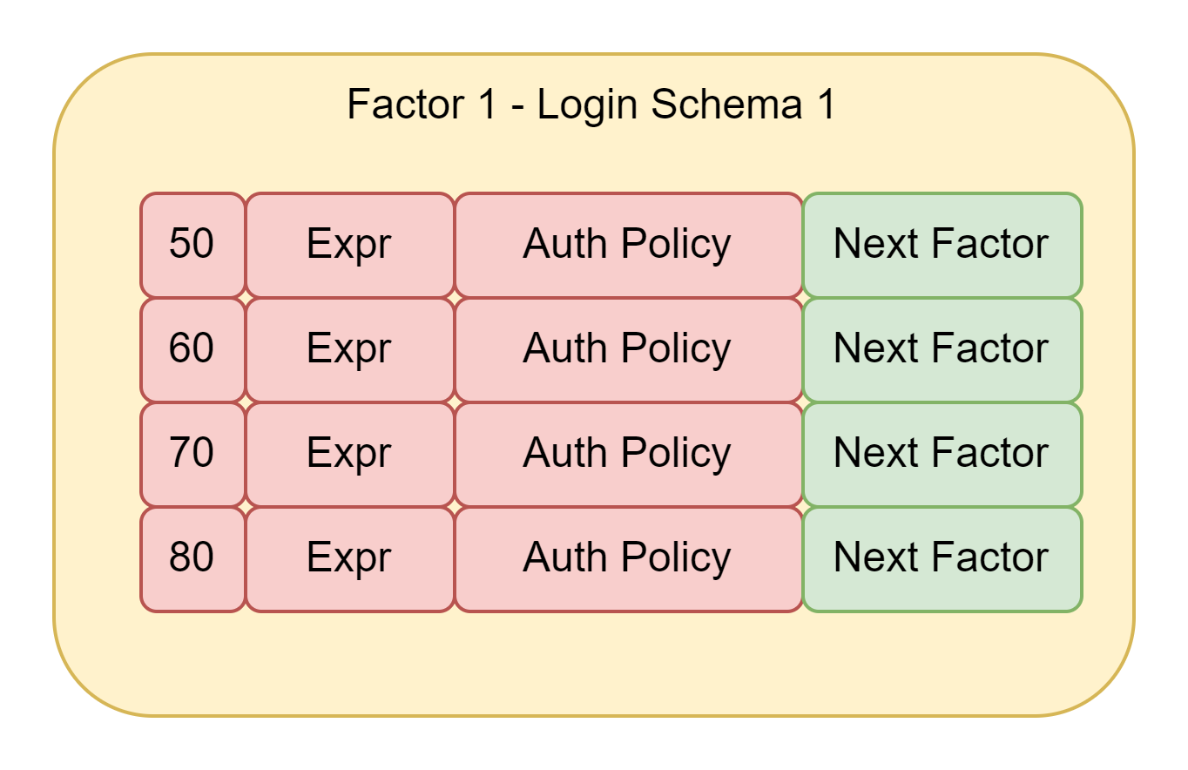
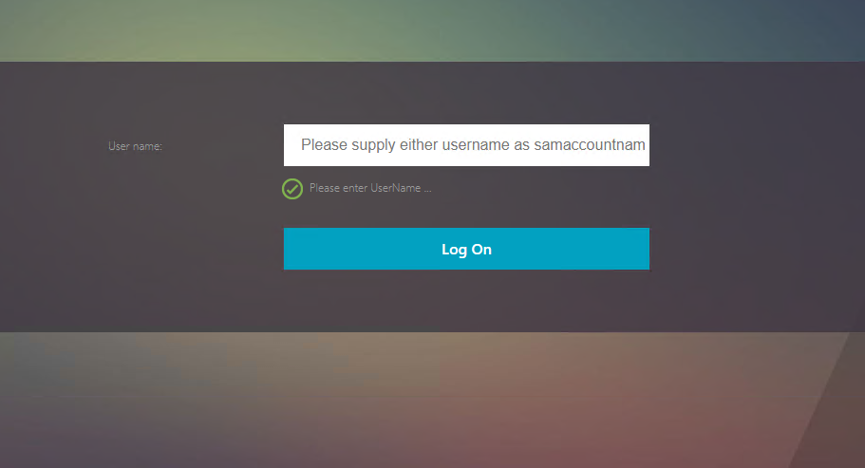
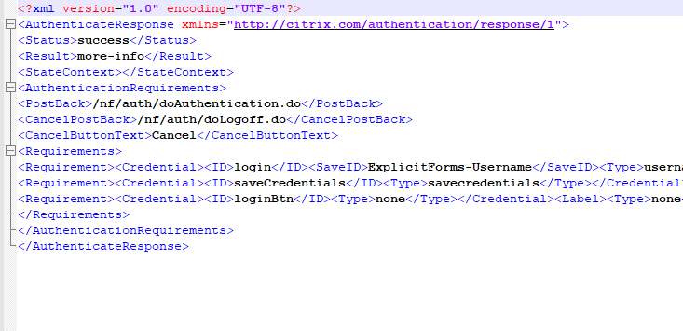
Guidelines
Login Schema
nFactor Graphical Layout
XML File structuring the Authentication Form (Similar to HTML Forms)
Custom Scripts & Plugins
Support Expressions

Slide 6
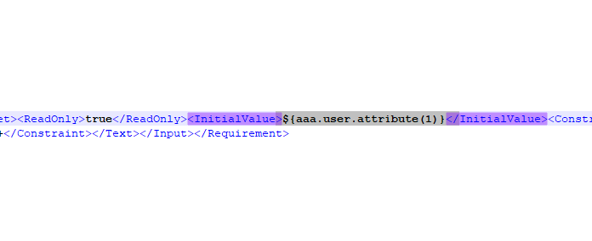
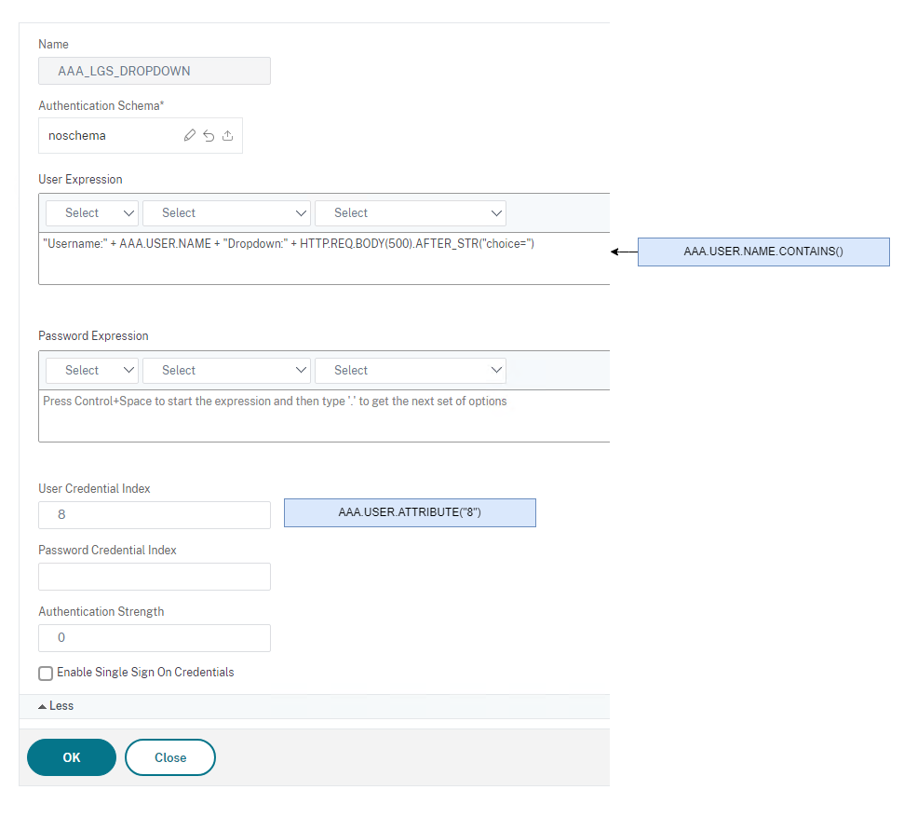
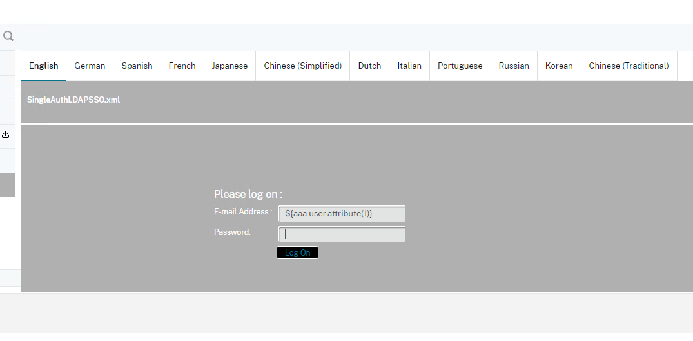
Guidelines
Login Schema
Attribute Assignment and nFactor Chain info
Expression & Policy reference
Login Schema layout Reference
Verify Chain Information

Slide 7
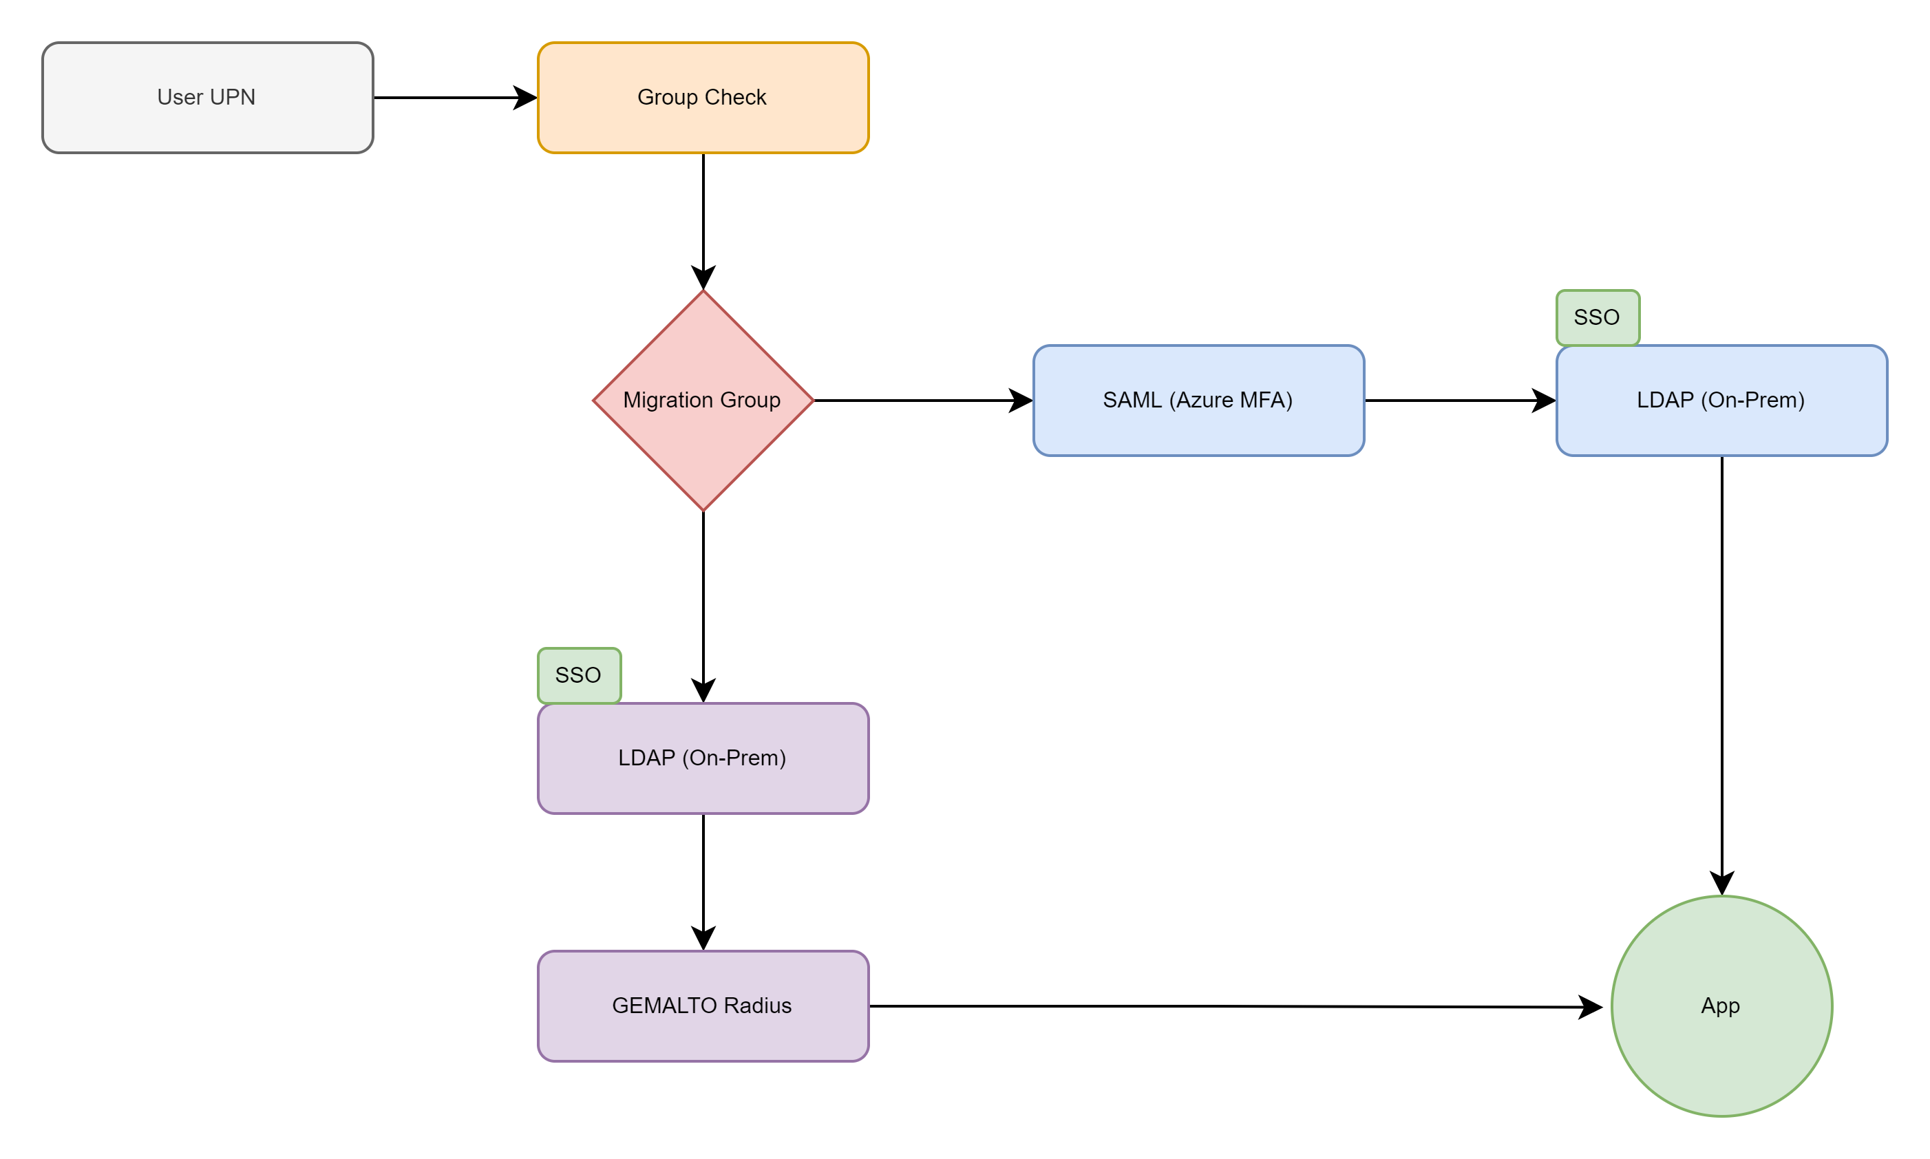
Guidelines
Login Schema
Chain Information Verification
Authorization Against User Impersonation

Slide 8
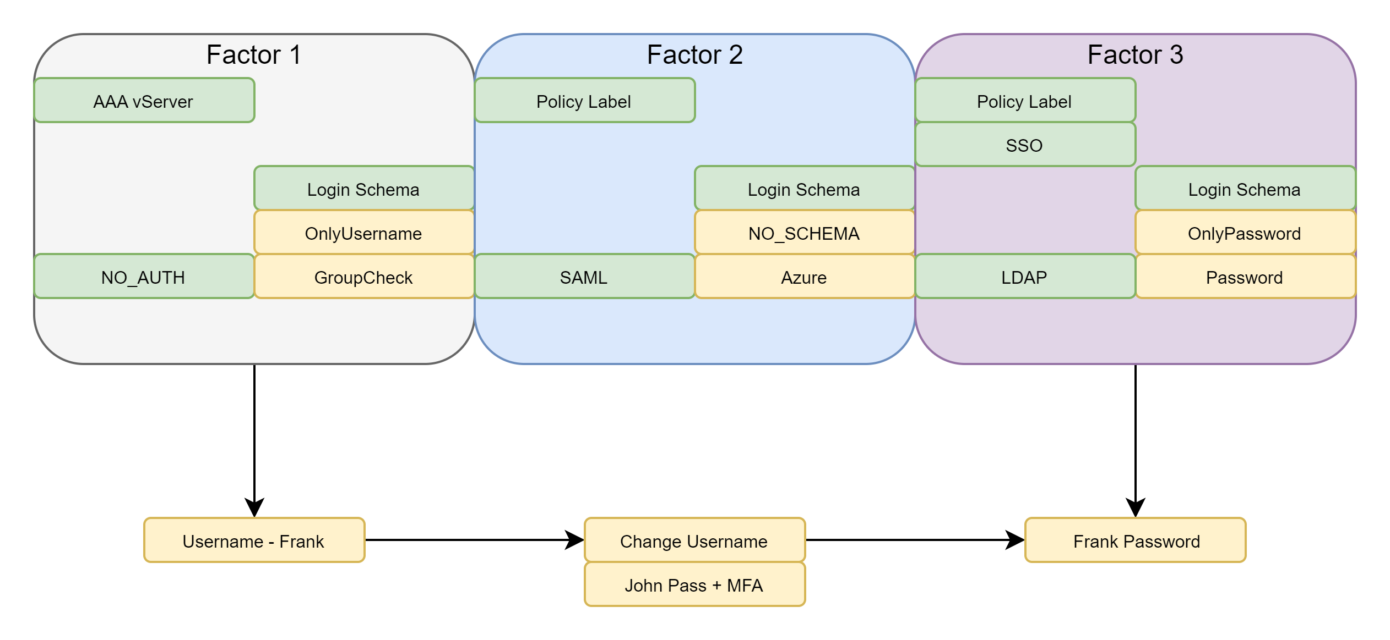
Guidelines
Login Schema
Chain Information Verification
Authorization Against User Impersonation
Username Verification
Login Schema Sanitization (Read Only Username)
Authorization: add authorization policy AUTHORIZE_POL_AZ "AAA.USER.ATTRIBUTE(2).EQ(AAA.USER.ATTRIBUTE(5)).NOT" DENY

Slide 9
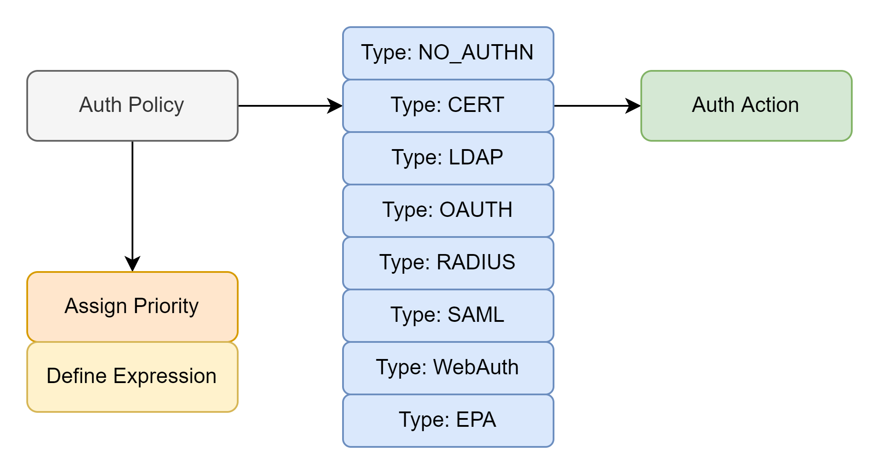
Guidelines
Authentication Policies
Usage & Examples
NO_AUTH: Authentication Failures (Quarantine Groups) Authentication Flow Branching Custom Javascripts
CERT: Authentication \ Considerations for TLS1.3 LDAP: Disable Authentication SAML: Group Extraction OAUTH: Custom Claims – 1:1 Group Mapping

Slide 10
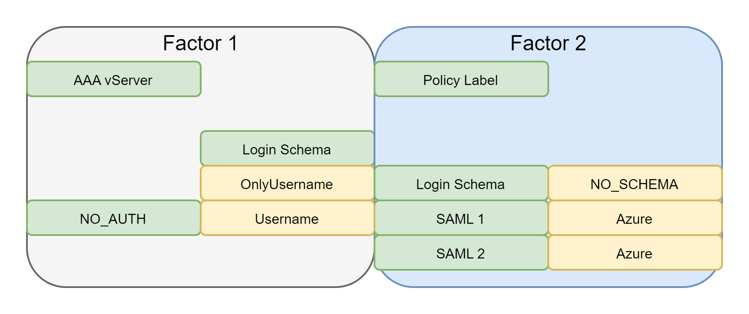
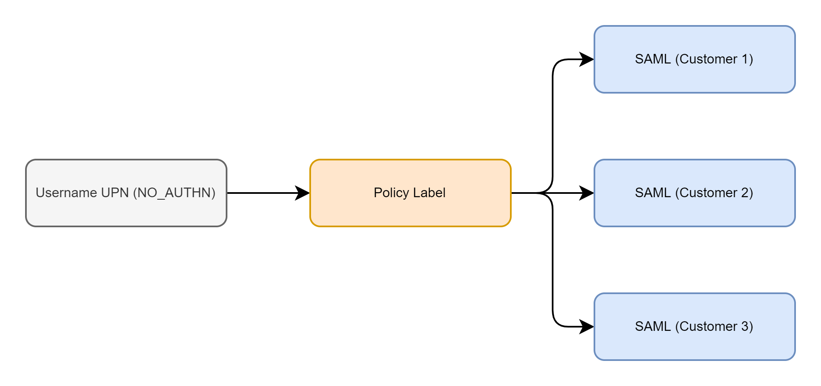
Guidelines
NO_AUTHN
Example
NO_AUTH: Authentication Flow Branching
SAML Policy Expressions: AAA.USER.NAME.TO_LOWER.CONTAINS_ANY("PS_EXTERNAL_CUSTOMERS")

Slide 11
Guidelines
NO_AUTHN
Example
NO_AUTH: Authentication Failures (Quarantine Groups)
CERT Policy Expressions: CLIENT.SSL.CLIENT_CERT.ISSUER.EQ("PrivateCA")

Slide 12
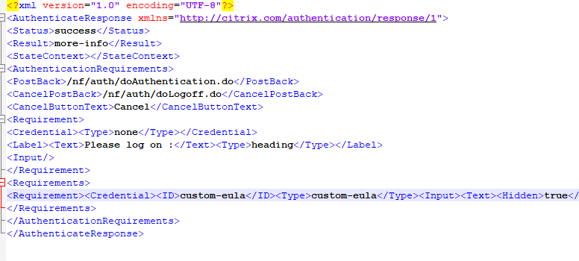
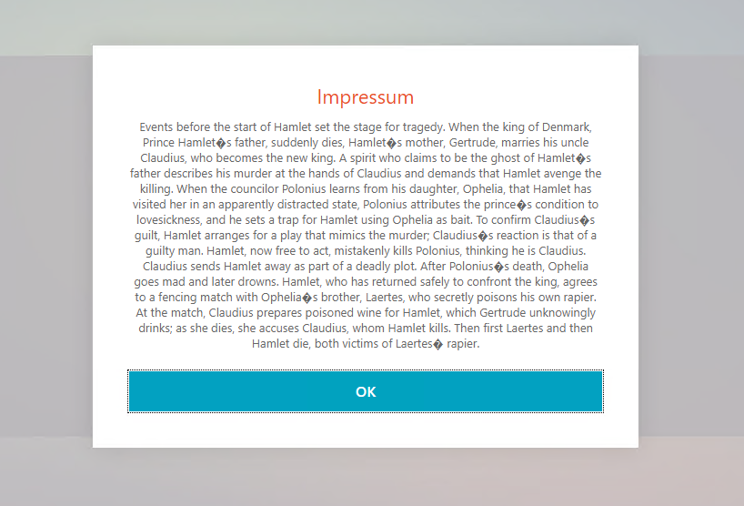
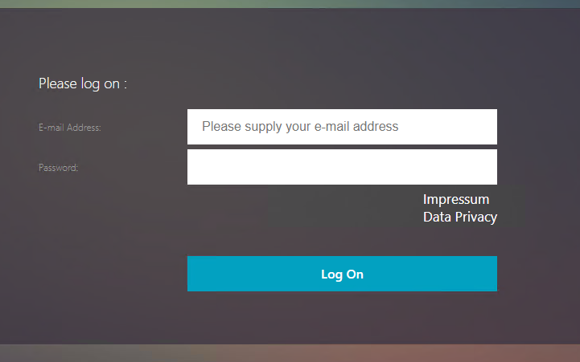
Guidelines
NO_AUTHN
Example
NO_AUTH: Custom Javascripts & Plugins
Login Schema: getCredentialTypeName: function () { return "custom-eula"; }

Slide 13
Service Health Verification in the nFactor Chain
Requirements:
Automatic fallback Authentication
Manual fallback (DR)
MFA UP: SYS.VSERVER("__Pri.LB#PLB_VS_MFA#MaxPri=3_LB1").STATE.EQ(UP) || MFA DOWN: SYS.VSERVER("__Pri.LB#PLB_VS_MFA#MaxPri=3_LB1").STATE.NE(UP) &&

Slide 14
Authentication Choices in the nFactor Chain
THE PLAN
Requirements:
Support Authentication Preference for SaaS Services
Expression: HTTP.REQ.BODY(500).AFTER_STR("domain=").CONTAINS("EID")

Slide 15
Authentication Choices in the nFactor Chain
Requirements:
Support Authentication Preference for SaaS Services
<DisplayValue><Display>AzureMFA</Display><Value>AzureMFA</Value></DisplayValue>

Slide 16
Authentication Choices in the nFactor Chain
THE IMPLEMENTATION
Limitations:
64 Policies per Policy Label
AAA.USER.NAME vs AAA.LOGIN.USERNAME
Expression: AAA.USER.NAME.TO_LOWER.CONTAINS_ANY("PS_GROUP_1")

Slide 17
Contextual Access in the nFactor Chain
Security Considerations:
AlwaysOn Tunneling – Service Desk & Admin Access
Different Subnets (IIP) for each level of Access
Smart Access Policies
EPA Access 1: sys.client_expr(\"os_0_win11\")&&sys.client_expr(\"app_0_ANTIVIR_0_0_RTP_==_TRUE... EPA Access 2: sys.client_expr(\"os_0_win11\")&&sys.client_expr(\"app_0_FIREWALL_0_0_ENABLED_==_TRUE... EPA Access 3: sys.client_expr(\"os_0_win11\")&&sys.client_expr(\"app_0_MAC-PATCH_0_0_ENABLED_==_TRUE...

Slide 18
Verification Order in the nFactor Chain
Decisions:
Multi-Screen
Each Factor is a separate Step in the GUI Login

Slide 19
Verification Order in the nFactor Chain
Password Expression on each Schema: AAA.LOGIN.PASSWORD AAA.LOGIN.PASSWORD2
Decisions:
Single Screen
Password Expression on each Schema: HTTP.REQ.BODY(1000).SET_TEXT_MODE(URLENCODED).TYPECAST_NVLIST_T(\'=\',\'&\').VALUE(\"passwd1\").DECODE_USING_TEXT_MODE

Slide 20
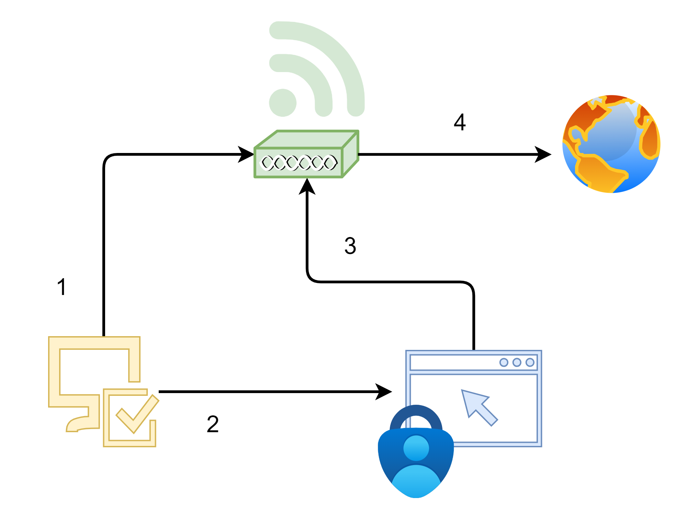
A Wireless Network
Traditional Access Points:
Minimize number of SSID
Captive Portals
Dynamic VLAN Assignment (based on RADIUS response)
Channel Distribution & Wireless Roaming (802.11r)
802.1X (Dot1x) – Certificate, Username & password
Bring Your Own Identity

Slide 21
A Wireless Network
Traditional Access Points:
Minimize number of SSID
Captive Portals
Dynamic VLAN Assignment (based on RADIUS response)
Channel Distribution & Wireless Roaming (802.11r)
802.1X (Dot1x) – Certificate, Username & password
Bring Your Own Identity

Slide 22
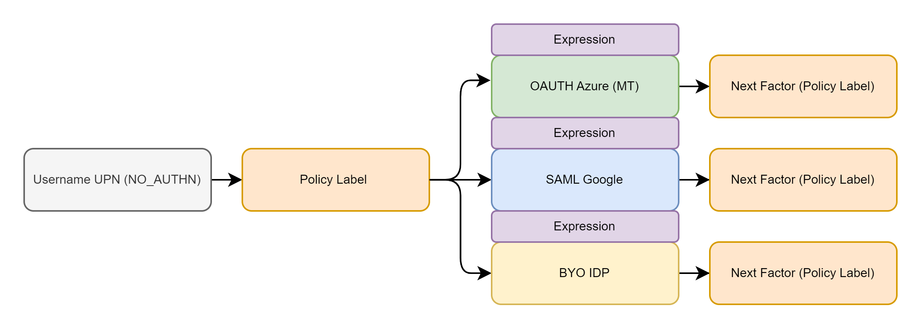
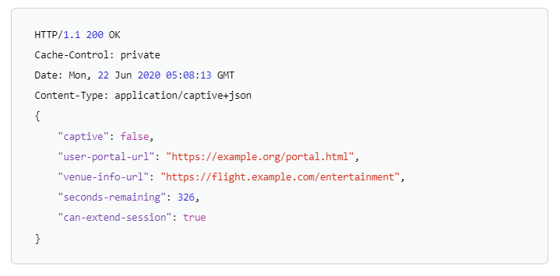
Our Wireless Network
Requirements:
Single SSID
Captive Portals
Multiple Companies
Dynamic VLAN Assignment
No Directory Service Database or Server (BYOI)
Captive Portal Detection
RFC 8910 – DHCP Option 114
Apple supports RFC 8910
HTTP Request
Android: connectivitycheck.gstatic.com
Microsoft: msftncsi.com

Slide 23
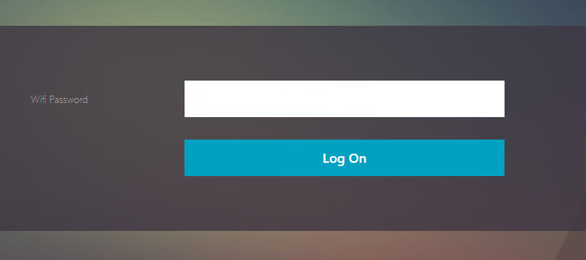
Our Wireless Network
MAC Address as Username (duplicate MACs)
We still require a password
Push Login info to the Access Point
AP info pushed via HTTP Callout:
MAC: CLIENT.ETHER.SRCMAC E-mail: AAA.USER.NAME WIFI Password: AAA.USER.PASSWD TMAS COOKIE: HTTP.REQ.COOKIE.VALUE("NSC_TMAS")

Slide 24
Q&A

Slide 25
Collaboration Betters The World

