Slide 1
Citrix NetScaler
Advanced Authentication Methods Citrix NetScaler & Azure AD
Citrix NetScaler

Slide 2
Alexander Kafedzhiev
E-mail: akafedzhiev@positivethinking.tech
Personal Blog: https://alekaf.com LinkedIn: https://linkedin.com/in/alekaf
Background:
Decade’s worth of IT experience.
Been working at PTC (Positive Thinking Company) for the last 3 years specializing in Citrix Networking Portfolio
Technical Skills:
Networking vendors as Citrix, Cisco, Palo Alto, HPE, MikroTik. Virtualization vendors as Citrix and VMware.

Slide 3
The Application World
Everything is Web delivered in a SaaS model.
Everything Is Connected to Everything Else
Everything requires Authentication
Identity Provider Services and Service Providers
Multi-Tenancy requirements
Notes:
Everything is Web delivered in a SaaS model.
Everything Is Connected to Everything Else
Everything requires Authentication Mechanism and building your own authentication system can take a lot of time and doing it incorrectly can be very costly.
Because of all this a rising complexity of IDP & SP integrations and new requirements for Multi-tenancy emerge.
And that’s what we’re going to talk about today - Authentication & Multi-Tenancy Integrations with Citrix NetScaler.

Slide 4
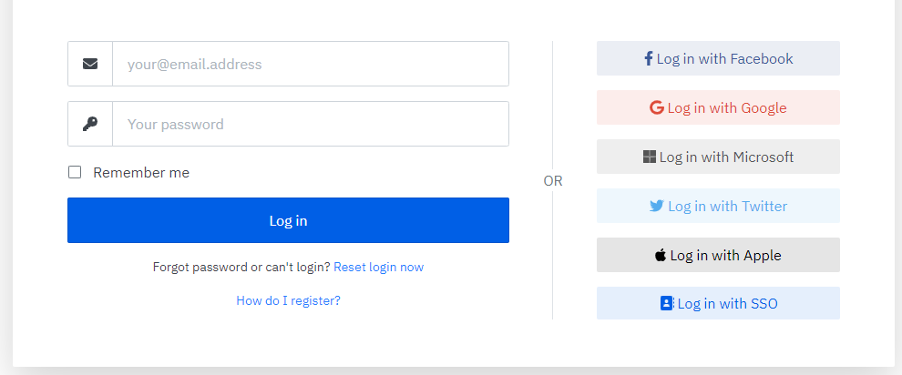
B2C Subscribers
Notes:
Let’s first have a look on the business model. On individual level, before organizational level.
A lot of services offer Personal Accounts & Company Accounts. Still this a B2C type of integration. We call these individuals subscribers.
If your application deals only with individuals and doesn’t have to make any decision based on organization no multi-tenancy is required.
But in the opposite case you’ll need a mean to identify the organization by their Tenant.

Slide 5
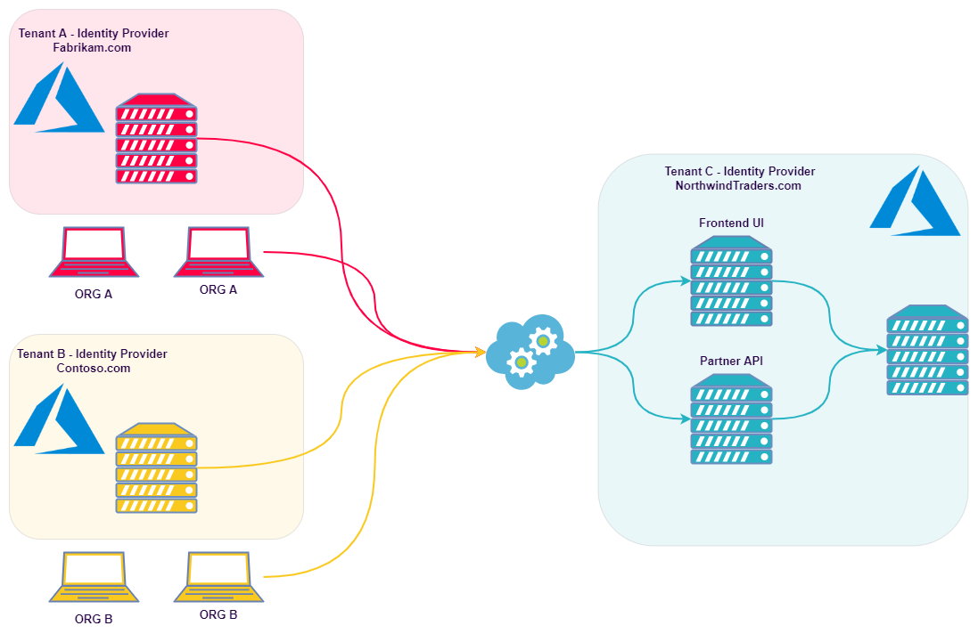
B2B Subscribers
Notes:
We now have the B2B type of Subscribers.
One Organizations subscribing for the services of another.
But what if that organization would like to access the resources authenticating to their own Identity Provider?
This could present a real challenge for your service complexity. Multi-Cloud, Multi-tenant customers.
Here the requirement for multi-tenancy comes in.

Slide 6
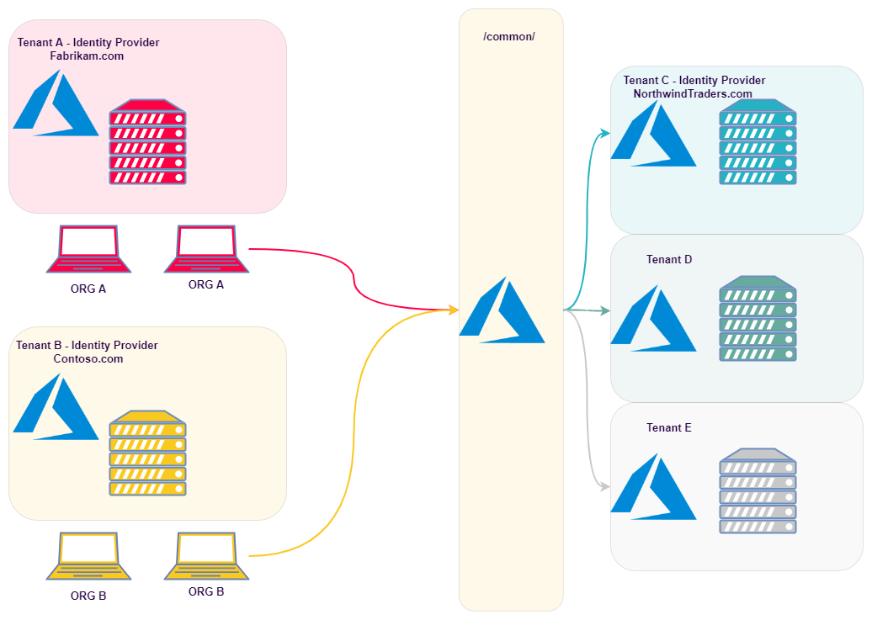
Single-Tenant vs Multi-Tenant
Organization = Cloud Tenant
Notes:
A Tenant is a Cloud representation of an organization’s resources and identity.
A single Tenant user would authenticate and access resource in their Organization’s Tenant.
Where Multi-Tenant User will need to access resources in any other cloud Tenants, but still authenticate towards their own Organization Identity Provider.
A Multi-Tenant Applications is represented by single Cloud Identity URL /common/, instead of user’s home tenant ID.
One important aspect of this /common/ URL is that it does not provide Tenant Filtering. Once you open your App Registration in Azure to Multi-tenancy all existing tenants in Azure will be able to authenticate and access your resources protected by that Azure App. The Tenant filtering (subscribers filtering) will have to happen on application side.
Like shown users from Fabrikam & Contoso organizations would like to access resources in Northwind Traders Organization, but authenticate towards their Identity Provider at Fabrikam & Contoso.

Slide 7
Multi-Tenant Cases
Notes:
We see Multi-tenancy most commonly in Azure, but same is valid for any other Identity Provider or Cloud Provider.
Let’s see typical cases where the Organization could benefit from Multi-Tenancy.

Slide 8
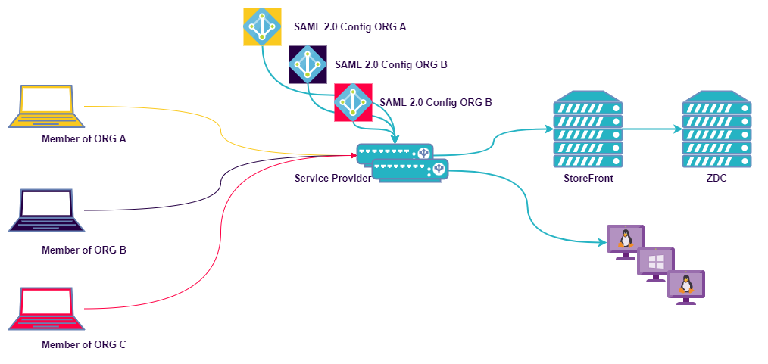
Multi-Tenant Cases
1. Full Desktops to their Customers & Partners.
Notes:
A Perfect Example is Organization providing full Desktops to their Customers & Partners. (NetScaler Gateway with HDX Delivered Desktops for different organizations)

Slide 9
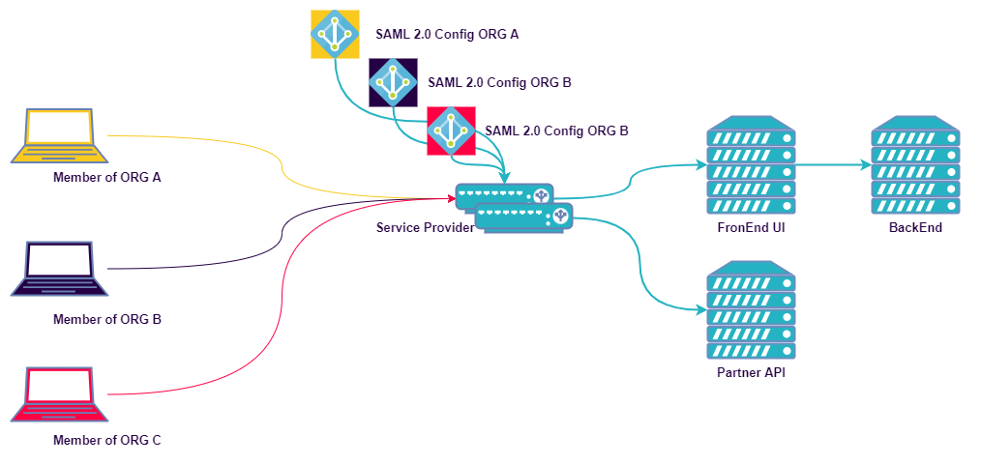
Multi-Tenant Cases
1. Full Desktops to their Customers & Partners.
2. Subscription Services for Customers & Partners.
Notes:
Another example is an Organization providing Subscription based Services to other organizations.
In these case the Customer’s Organization might come with their own Identity Provider or the Service Provider could create it for them.
So far, we talked about Organizations coming with their own Identity Provider, but there could be Tenants representing Subscribers managed by the Service Provider (your organization).
The purpose is Organization segmentation. Customers need to pay only for the services they use.
Usually, SP managed Tenants have same structure, but different owner.
An Internal Directory Service (regardless, if it’s Microsoft’s Active Directory) associated with that customer.
Azure Tenant, AWS Tenant or GCP Tenant (associated with that customer).
The exact concept of DaaS and SaaS services. Permission delegation across such environments and control over authentication methods requires the use of multi-tenant environments.

Slide 10
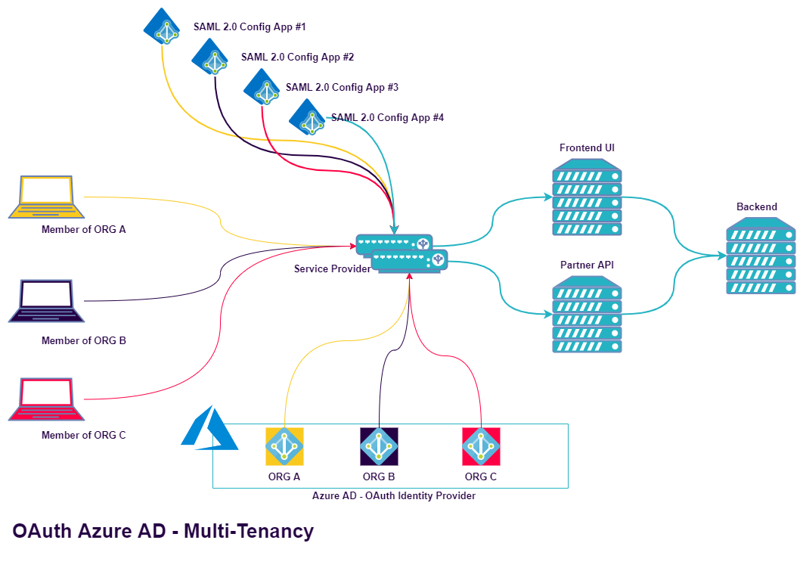
Single-Tenant Concept
Notes:
Let’s examine how we did the single tenant implementations.
How we used to do it and how OAuth and SAML Multi-tenancy help us.
We configured in the past an application per customer/tenant. We had multiple single tenant application configurations, where the customer will be Redirected to their Tenant IDP for Authentication.
Some configurations were getting so extensive we hit limits on number of Authentication Policies bound to a Policy Label.

Slide 11
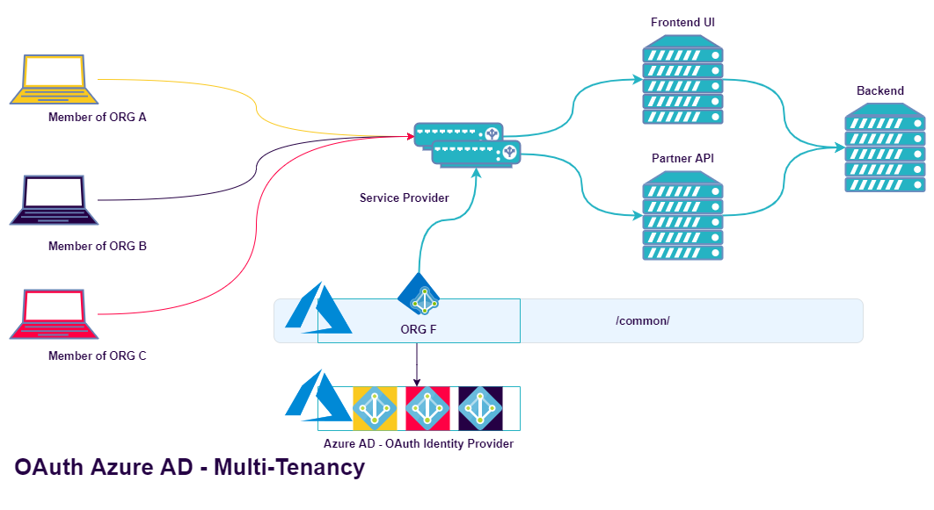
Multi-Tenant Concept
Notes:
With Multi-Tenant applications we need only one single application configuration.
The customer will be directed to a Cloud Identity URL /common/ applicable to all Tenants in Azure and after populating username he’ll be directed to their Tenant & Identity Provider.

Slide 12
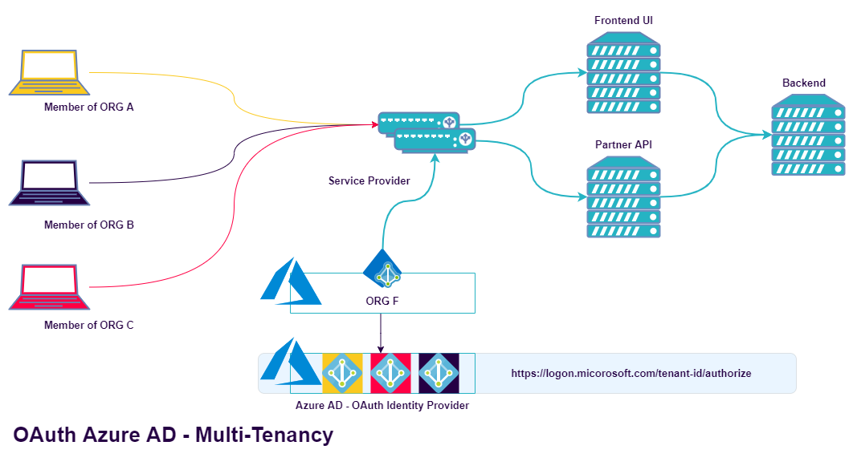
Multi-Tenant Concept
Notes:
Multi-tenant application allows access to your application from any Tenant.
This means all existing Tenants and that’s the main problem. You need to filter your subscribers and we’ll see how a bit later on.
A very important note is that the Control over AAA Policies, MFA, Lockout Setting, Contextual Access will remain in their user’s home Tenant.

Slide 13
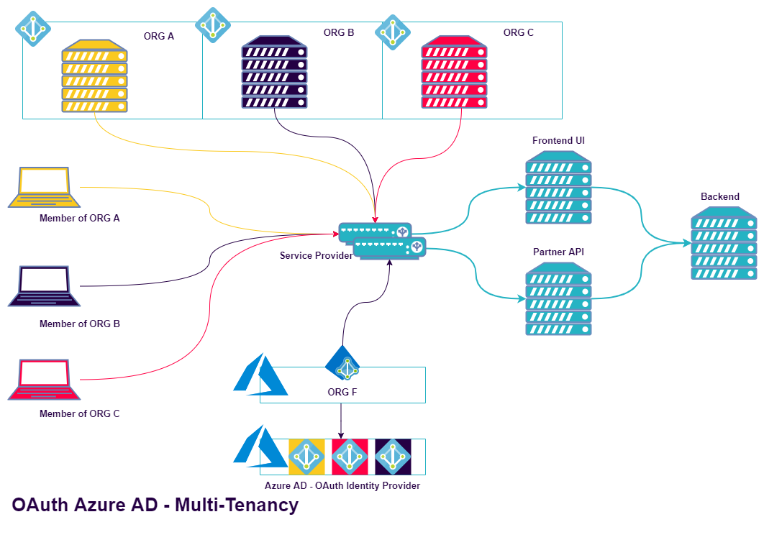
Simplicity & Flexibility
Notes:
This type of approach provides us additional flexibility. This single Authentication Configuration could be shared between browser based and non-browser-based agents for providing access to resources.

Slide 14
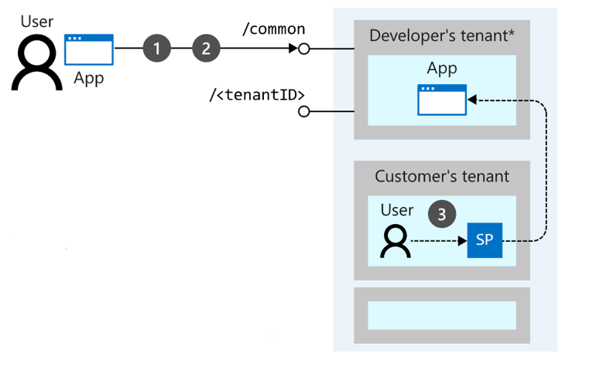
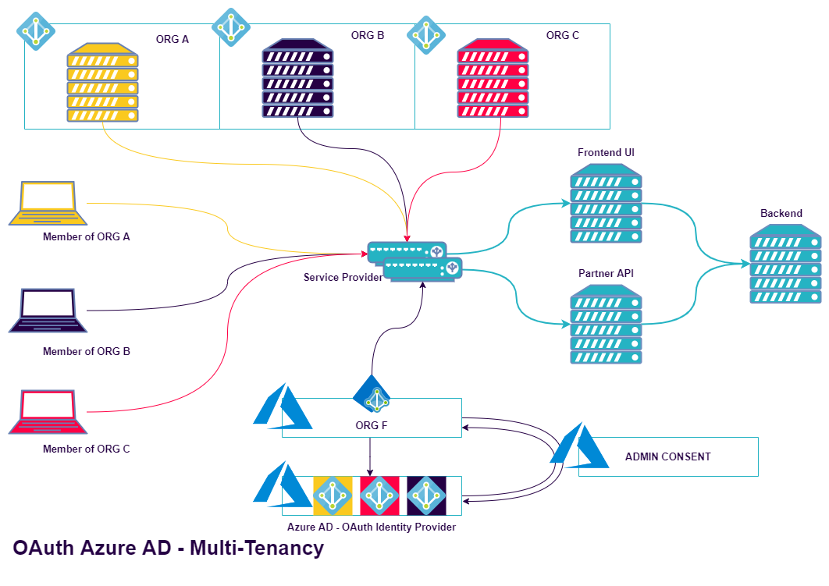
Tenant Admin Consent
Notes:
For a user to sign into an application in Azure AD, the application must be represented in the user’s tenant.
This allows the organization to do things like apply unique policies when users from their tenant sign into the application.
For a single-tenant application, this registration is easier; it is the one that happens when you register the application in the Azure portal.
For a multi-tenant application, the initial registration for the application lives in the Azure AD tenant used by the developer.
When a user from a different tenant signs into the application for the first time, Azure AD asks them to consent to the permissions requested by the application.
If they consent, then a representation of the application called a service principal is created in the user’s tenant, and sign-in can continue.
A delegation is also created in the directory that records the user’s consent to the application.
You can provide consent via two ways for the Multi-Tenant Application.
Consent via Publisher Verification (Microsoft Partner)
Admin Consent Workflow – An admin consent to be provided on behalf of the whole organization (your subscriber).

Slide 15
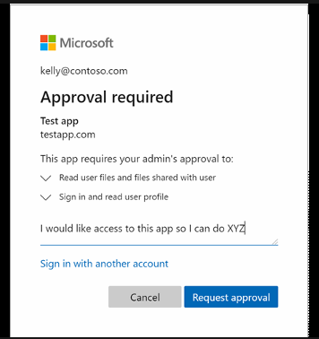
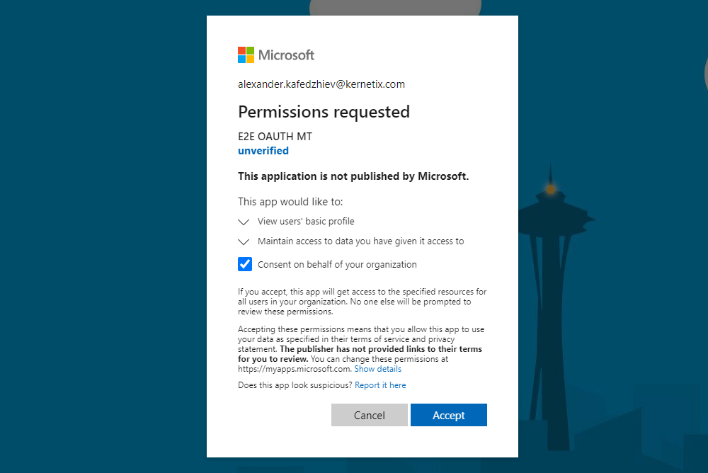
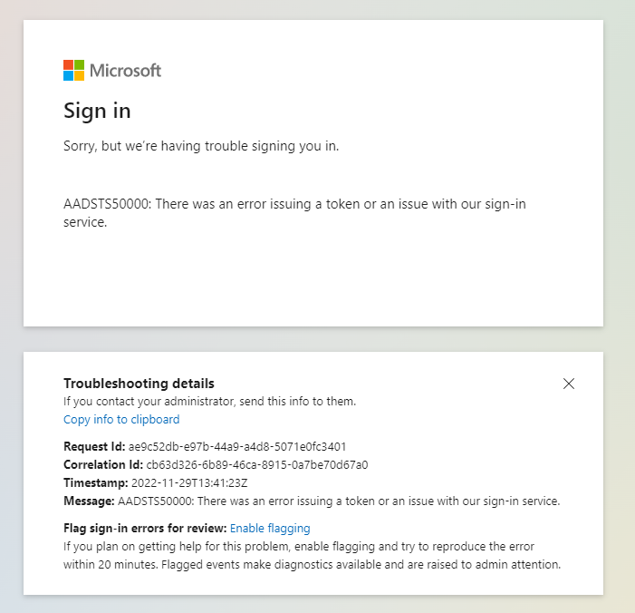
Tenant Admin Consent
Notes:
Depending on your organization settings or account you use, you might receive a screen to request access, be presented with an error or consent on behalf of your organization (full admin account).

Slide 16
Authentication Protocols
OAuth
Authorization Code Flow – OpenID Extension (OIDC)
Resource Owner Password Flow
Client Credentials Flow
SAML
Assertion (Bindings) - Support for POST & Redirect
Notes:
Any IDP should be able to provide you Multi-Tenant Applications in order to ease the integration between organizations.
In fact any authentication protocol may potentially support Multi-Tenancy. The only questions is if the Cloud Identity Provider supports it.
Two authentication protocols make perfect case for Multi-Tenancy, because of claim use and because of Cloud Tenant Federations.
Meaning one Tenant trusting the other for the authentication and creating Service Principals for that user.
In SAML we have an Assertion binding to choose.
Azure AD with SAML2 supports only Front-channel bindings like POST & Redirect. SAML implementations typically exchange sensitive user data via the browser. This considerably increases the attack surface of your Single Sign-On (SSO) solution. SAML offers an alternative mechanism called HTTP Artifact binding that allows protocol messages to be transported more securely. Both HTTP Redirect and HTTP POST are front-channel bindings, where SAML HTTP Artifact binding sends protocol messages using a direct server-to-server connection between an Identity Provider (IdP) and a Service Provider (SP).
In OAuth we have different authentication flows (or grant types) to consider. The NetScaler support two of them - Authorization Code Flow & Resource Owner Password Flow. The most recommended (for agents supporting redirect) and the least recommended. The NetScaler can always validate a token acquired out-of-band.

Slide 17
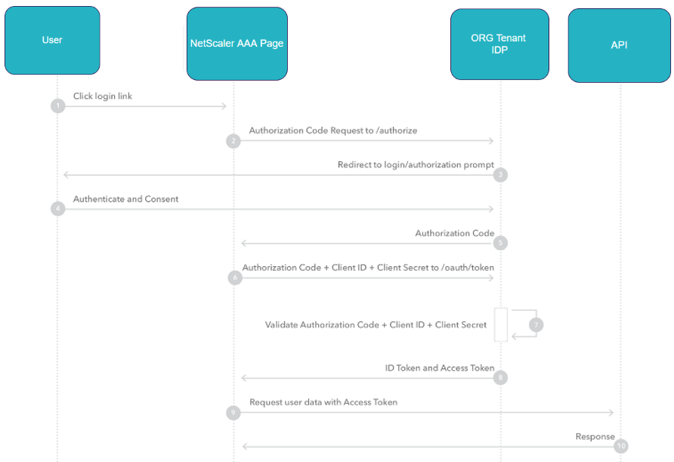
OAuth Authorization Code Grant
Notes:
The NetScaler supports “Authorization Code Flow” with id_token extension and Resource Owner Password Flow as a Service Provider. Let’s Explore the OAuth Authorization Grant.
This Authorization Flow is redirect based flow, so usually involves usage of browser as user-agent.
1. The Customer/User tries to access NetScaler Authentication Protected Resource and subsequently is Redirected to the IDP logon page.
2. After successful Authentication the IDP issues an Authorization Code.
3. The IDP Redirects the User-Agent with the Authorization Code back to the SP (the NetScaler).
4. NetScaler sends to the IDP – Authorization Code, Client ID (Application ID) and Client Secret to receive an id_token and access_token.
5. The NetScaler allows access by the validating the token.
The id_token or the access_token could be acquired out-of-band – directly from the IDP. Then you can directly present the id_token to the NetScaler by inserting it in an Authorization Header.

Slide 18
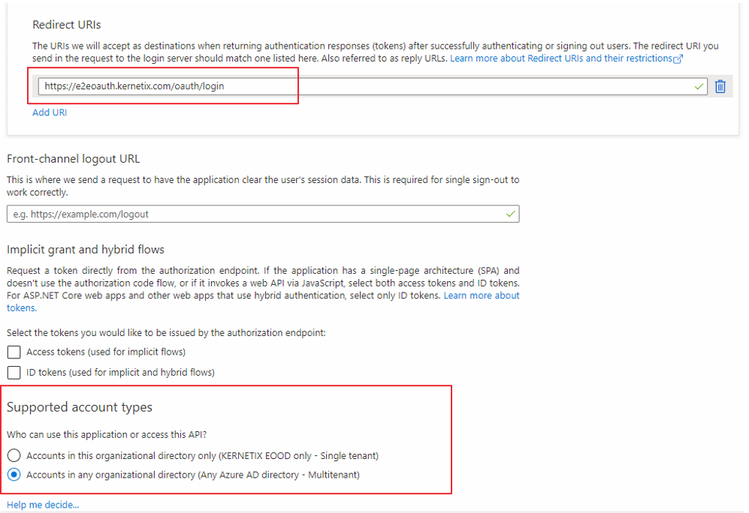
Azure AD Config

Slide 19
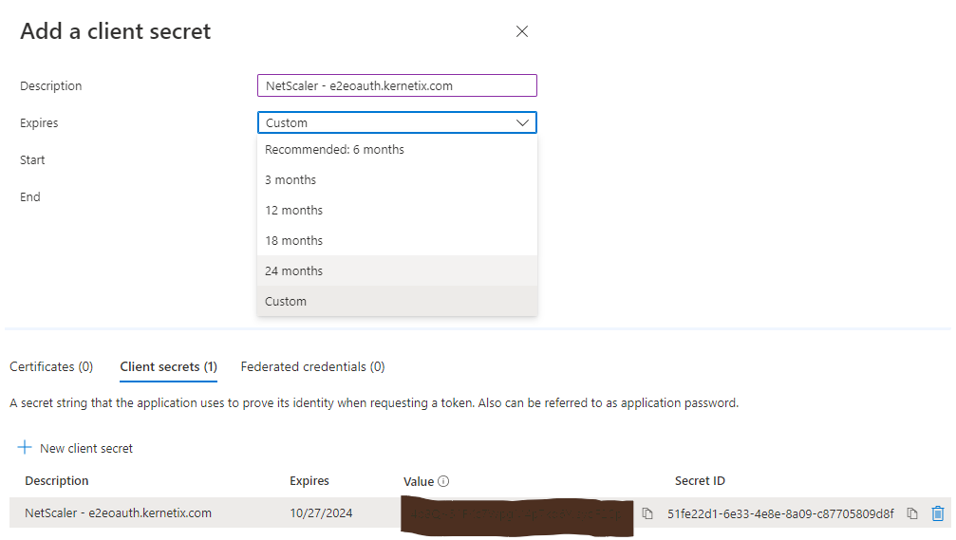
Azure AD Config
Notes:
Client Secret – 24 months max. Special characters requirement per your local NetScaler policy.

Slide 20
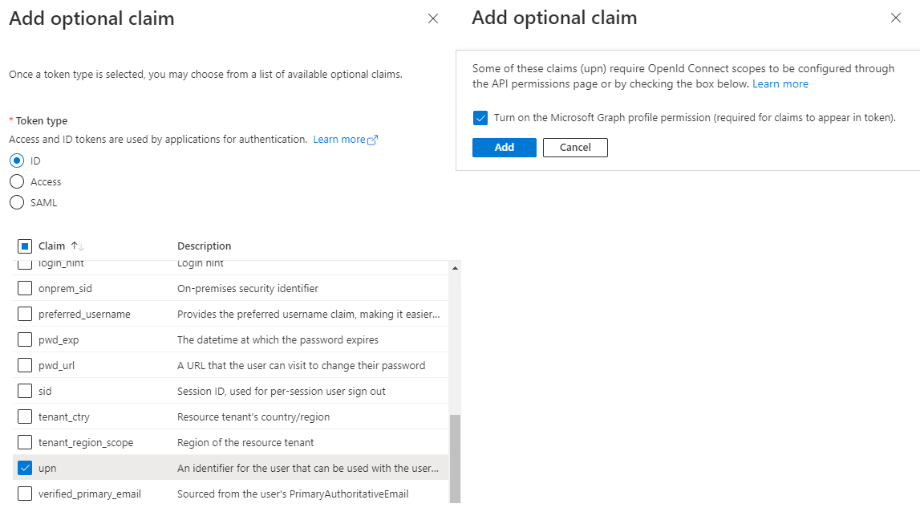
Azure AD Config
Notes:
I would add UPN or preferred_username as additional claim that will appear in the ID Token.
This will ensure NetScaler is Identity aware, not just verifying the tokens.
Claims are assertions that one subject makes about itself. (in this case the Authorization Server / User context)
OAuth Scopes are groups of claims.
For example, the Id_token will consist of some OpenID Connect Claims with information about the Resource Owner, maybe their first and last name, email or address.
They can also carry information about the OAuth Client or the token itself, like who issued the token or what is its intended audience.

Slide 21
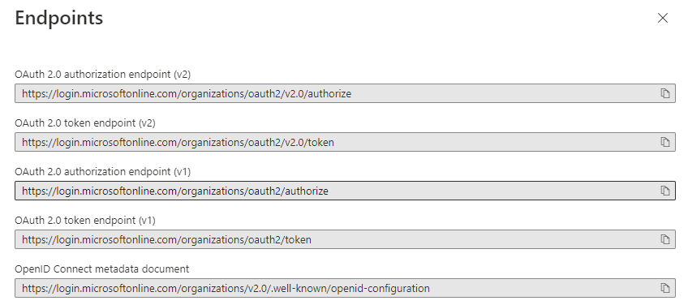
Azure AD Config
Endpoints
Authorization Endpoint – Login and authorize the access
Token Endpoint – Access token or a Refresh token
Cert Key Endpoint – JWT Public Cert Endpoint
JSON Web Token public keys access
Outbound access to login.micosoftonline.com
ST URL | https://login.microsoftonline.com/7b027649-48a4-4b51-9fbb-f035395571ad/discovery/v2.0/keys
MT URL | https://login.microsoftonline.com/common/discovery/keys
Notes:
You’ll need 3 endpoints.
Two of them are listed in your Azure App Endpoints.
The outbound Source IP depends on your configuration for reaching “login.microsoftonline.com”. You can see the difference between Single Tenant URL and Multi-Tenant URL.
The /common/discovery/keys is not listed in your App Endpoints, but you’ll need it.
This same id_token or access_token will be included in the Authorization Header into the HTTP request.

Slide 22
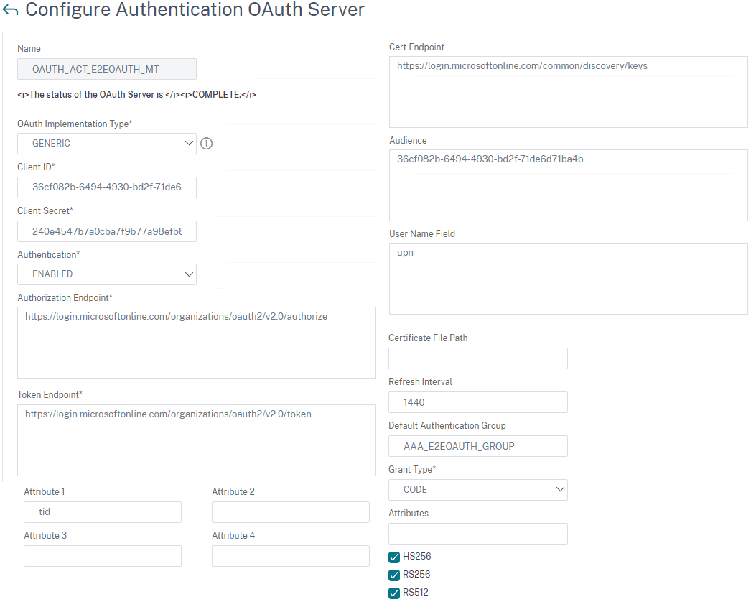
NetScaler Config

Slide 23
NetScaler Config
Notes:
State of the oAuth Action. Complete will indicate successful fetch of the certificate.

Slide 24
NetScaler Config
Notes:
Client ID – This is the application ID from Azure AD.

Slide 25
NetScaler Config
Notes:
Client Secret.

Slide 26
NetScaler Config
Notes:
Authorization Endpoint – Login and Authorize the Access.

Slide 27
NetScaler Config
Notes:
Token Endpoint – The NetScaler will request an Access Token on this URL providing the Authorization Code, Client ID & Client Secret.

Slide 28
NetScaler Config
Notes:
Cert Endpoint – Fetching the public keys for decrypting the token. (There are multiple keys)

Slide 29
NetScaler Config
Notes:
Grant Type – oAuth Authorization Flow Type

Slide 30
NetScaler Config
Notes:
upn - Username claim extraction.

Slide 31
NetScaler Config
Notes:
NetScaler Group in which the User will be placed after successful authentication & acquired token. This AAA Group will be used for our authorization purpose. (subscriber filtering)

Slide 32
NetScaler Config
Notes:
tid – a default claim included in every token from Azure AD indicating the home Tenant of the User. We’ll authorized the connection based on that tid value.

Slide 33
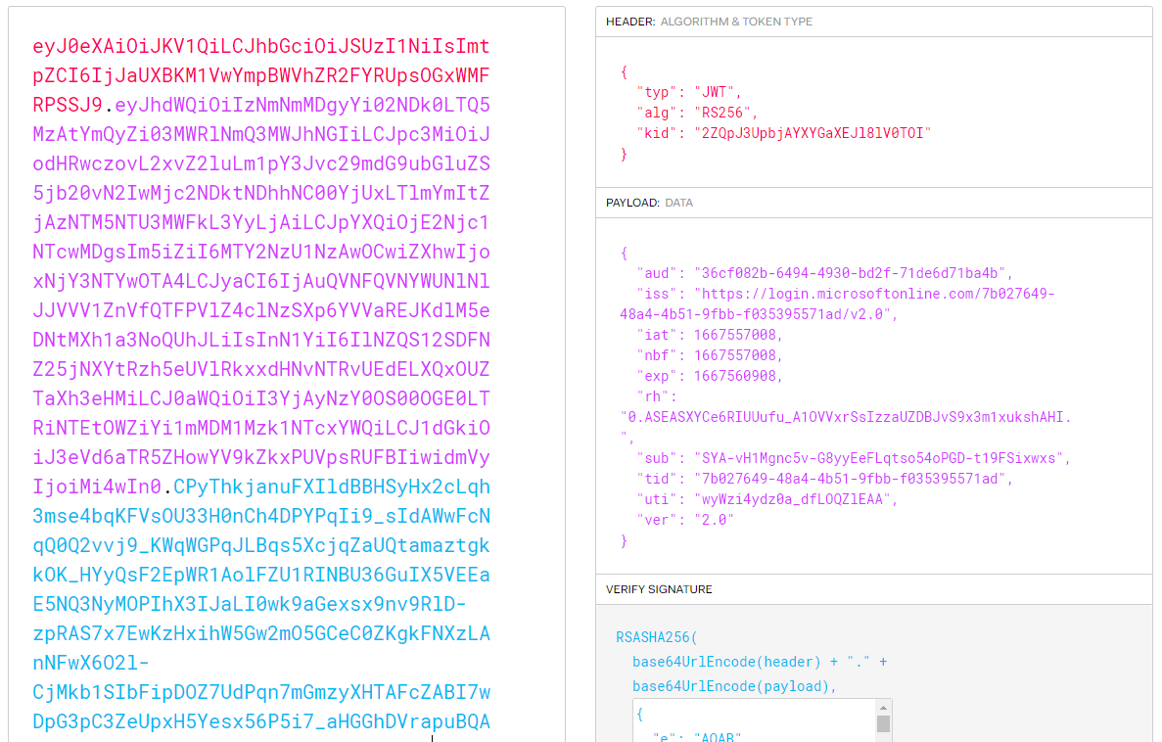
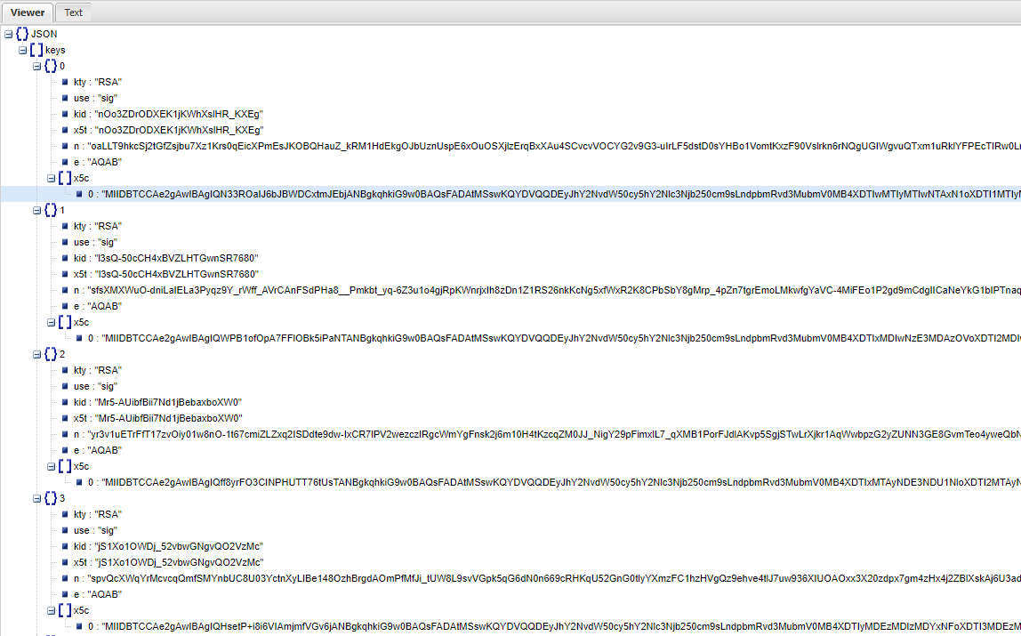
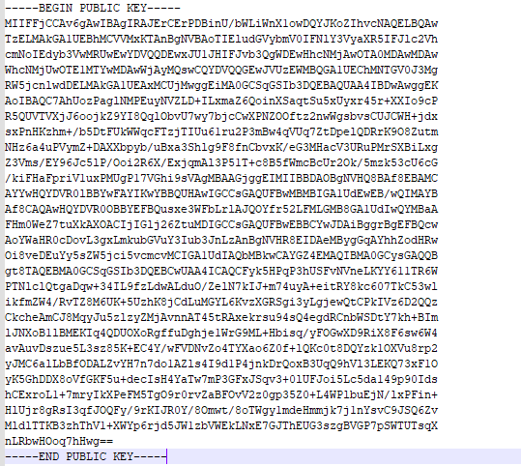
NetScaler Config
JSON Web Token Decode | https://jwt.io
JSON Web Viewer | Online JSON Viewer (stack.hu)
Notes:
Cert Endpoint Clarification and Certificate handling:
The JWT Token consists of 3 Portions:
Header
Payload
Signature
The NetScaler will look into the Header portion for ‘kid’ header value. This value indicates which certificate has been used for the encryption of the token. He then decrypt the token and have the user’s Identity Information.

Slide 34
NetScaler Config
Tenant Authorization – Tenant (Subscriber) Filtering
Notes:
A pattern set contains a name of one or more string patterns that can be used in policy expressions.
The patter set must include the Tenant IDs of all our subscribers.
We create the patter set which is afterward used in the authorization policy binding to the AAA Group.
add policy patset PS_AZ_OAUTH_TID
bind policy patset PS_AZ_OAUTH_TID bc2a1323-24ef-4fdd-869a-8a4bf7dd7912 -index 1
bind policy patset PS_AZ_OAUTH_TID 1232a63e-308d-4dd2-9dbc-8c9e9e644876 -index 2
bind policy patset PS_AZ_OAUTH_TID 321814db-fda6-4ff9-bffa-619ca66b54f7 -index 3
bind policy patset PS_AZ_OAUTH_TID 123dd211-bf2e-40ab-8b84-33ecb65b06b8 -index 4
bind policy patset PS_AZ_OAUTH_TID 165sasd3-d8f3-4dfc-89c5-8647d1ba5b59 -index 5
bind policy patset PS_AZ_OAUTH_TID 12rfe43d-19d7-4a12-8ef1-180d44f9ed10 -index 6
bind policy patset PS_AZ_OAUTH_TID 7b027649-48a4-4b51-9fbb-f035395571ad -index 7
add authorization policy AUTHORIZE_POL_AZ_TID "AAA.USER.ATTRIBUTE(1).CONTAINS_ANY(\"PS_AZ_OAUTH_TID\")" ALLOW
add aaa group AAA_E2EOAUTH_GROUP
bind aaa group AAA_E2EOAUTH_GROUP -policy AUTHORIZE_POL_AZ_TID -priority 90 -gotoPriorityExpression END

Slide 35
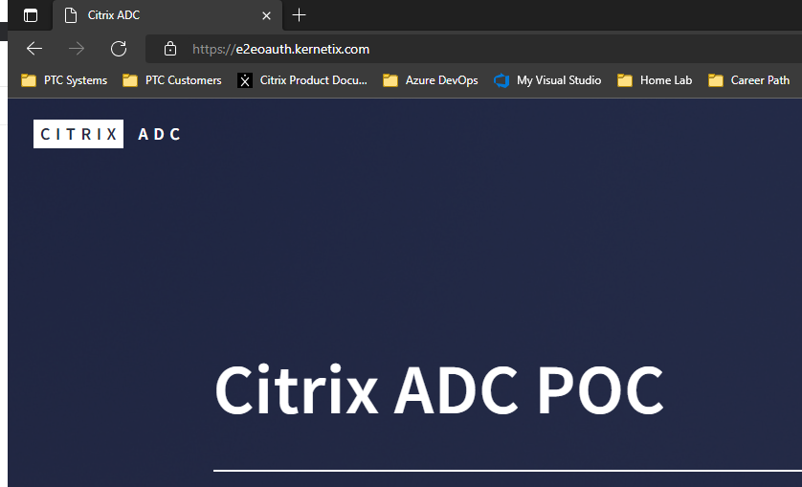
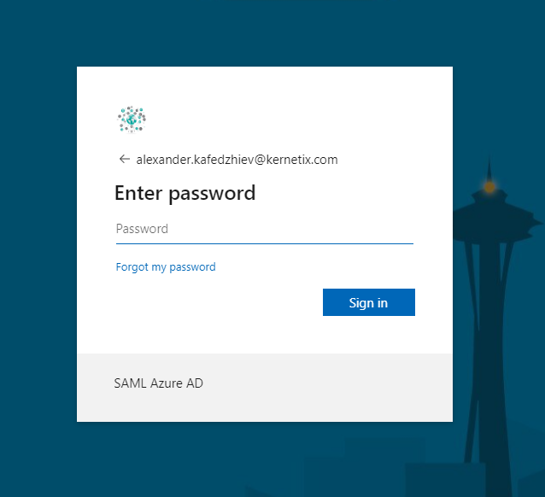
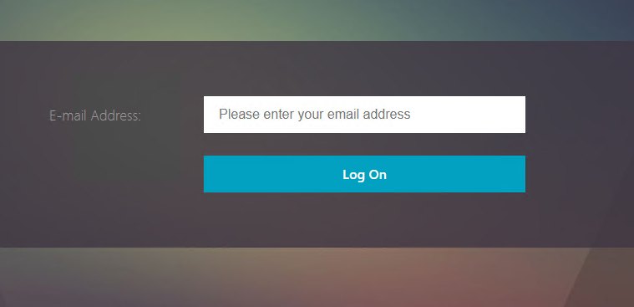
User Experience - nFactor
3. Backend Resource Server
2. Azure IDP OAuth – Pre-filled Username
1. Citrix NetScaler
Notes:
All this can be fully integrated in a nFactor Authentication Flow.
This is how the user experience would look like.

Slide 36
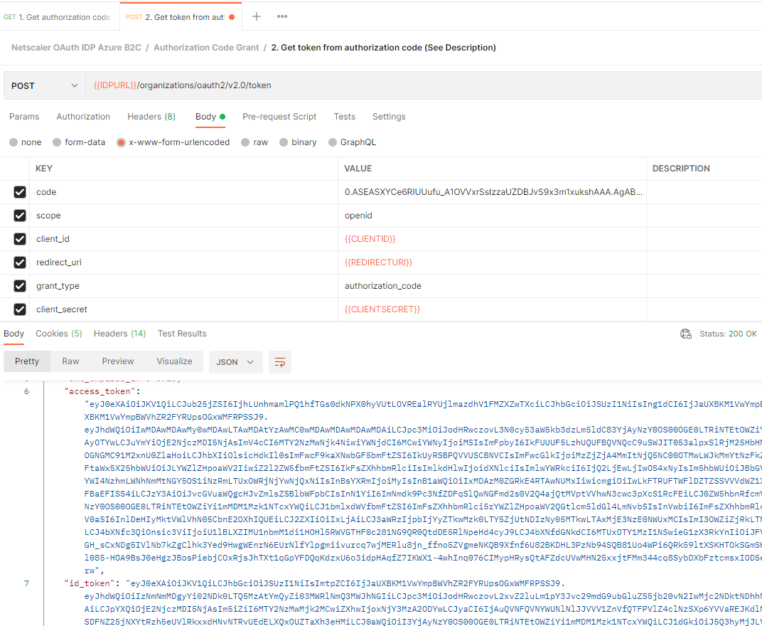
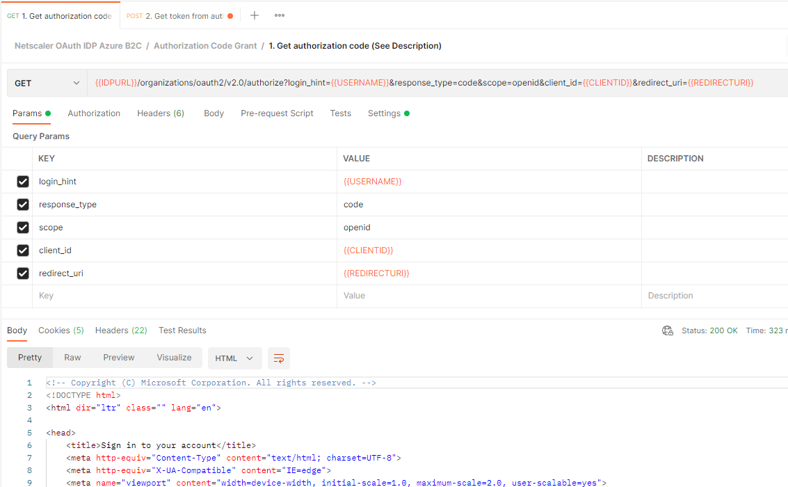
POSTMAN Verification
1. Flow Verification with Postman
2. id_token for Resource Access
Notes:
You can verify the Authorization Code Flow through Postman. Full files for postman will be provided with the upcoming video.

Slide 37
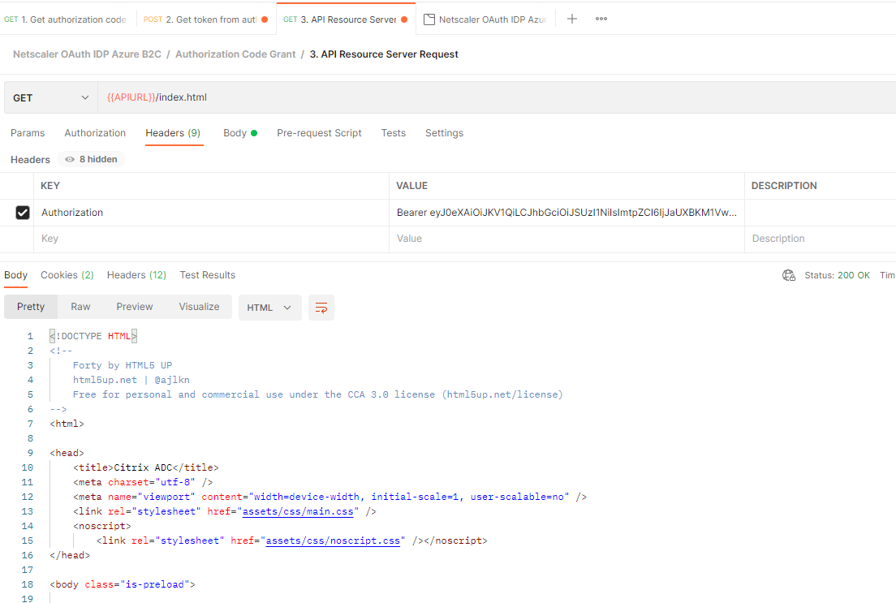
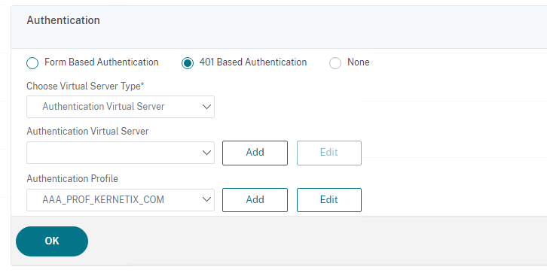
API – 401 Authentication
POSTMAN GET /Backend Resource Server
Swtich LB vServer Authentication to 401 Based Authentication
Notes:
The postman verification will basically test out-of-band acquired token. This means API call with Authorization Header. In order this to work you must switch to 401 Authentication or have a second Load balancer with it, if you want to run both in parallel.

Slide 38
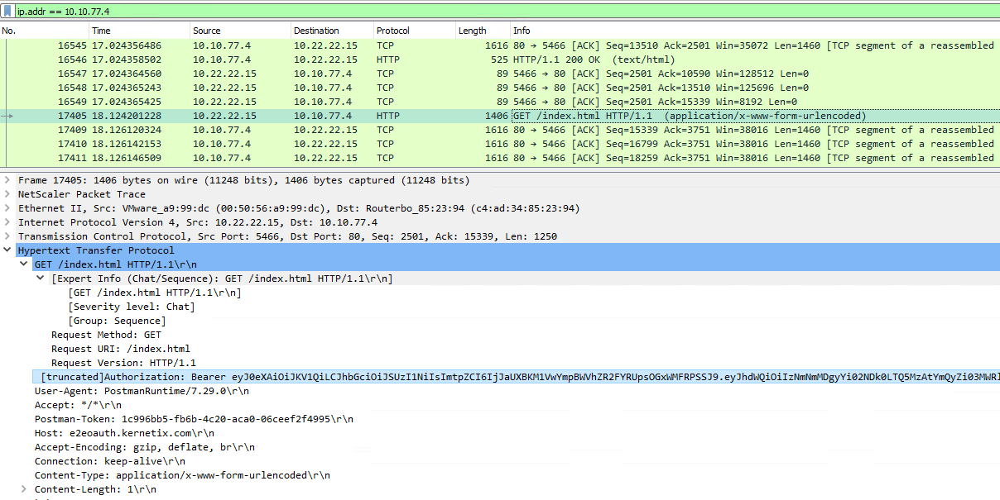
API Use Case
Insert Token Towards Backend
Network Trace Towards backend
Notes:
Authorization Header will be by default stripped from the API call. Often you wish the backend to receive that token along with the request. You can do so by implementing the below rewrite policy.
Note: This will work only on the 401 Authentication method (API).
add rewrite action RWR_ACT_INSERT_BEARER insert_http_header Authorization "\"Bearer:\"+\"AAA.USER.ATTRIBUTE(accesstoken)\""
add rewrite policy RWR_POL_INSERT_BEARER true RWR_ACT_INSERT_BEARER
bind authentication vserver AAA_VS_KERNETIX_COM -policy RWR_POL_INSERT_BEARER -priority 10 -gotoPriorityExpression END -type AAA_RESPONSE

Slide 39
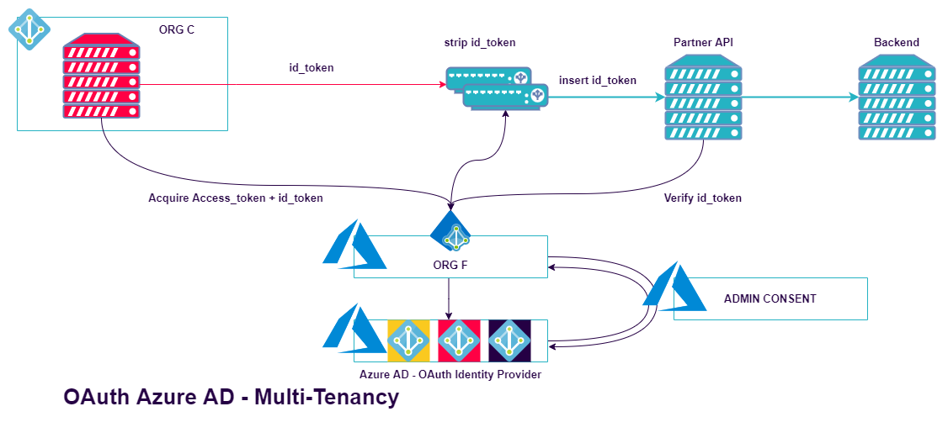
API Use Case
ID_TOKEN insert will work only with out of band acquired tokens
Native clients can obtain tokens out of band and can present those tokens to the NetScaler appliance for access.

Slide 40
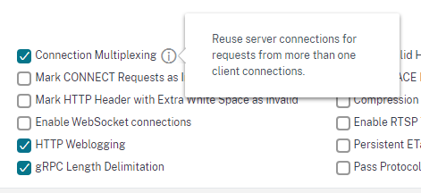
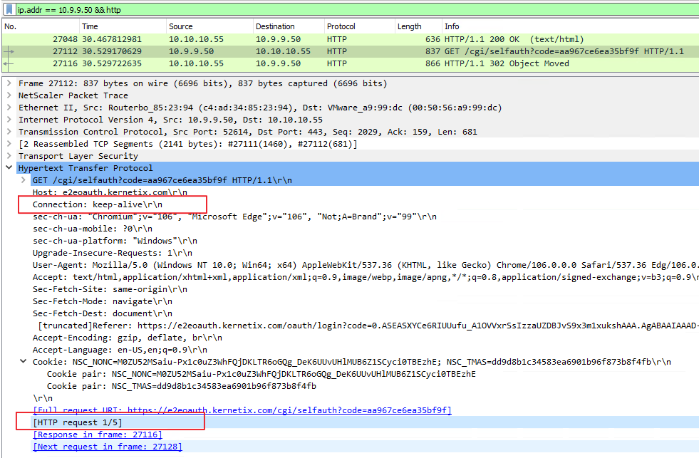
Connection Multiplexing
HTTP Connection Reuse
Controlled via “Connection” Header
Should include NetScaler AAA cookie – NSC_TMAS
Notes:
There’s a little catch:
What is Connection Multiplexing? Sending several HTTP requests in the same TCP connection.
If your API Clients use Connection Multiplexing it might not work.
REST APIs are stateless by definition. They do not keep cookies in the traditional browser based agents.
NetScaler uses the TMAS cookie to track that state.
Based on that cookie NetScaler will apply the Connection Multiplexing.
Either your APIs should cache the cookies or you should disable connection multiplexing.
You can disable it from the HTTP profile.
Unfortunately, this will affect the Front-end & the Server Back-end behavior of the Load Balancer. Where we wish to suspend it only for the Front-end. We want the connection Multiplexing to continue work for the backend.
Ideally the HTTP state should be tracked via the Authorization Header, not via the TMAS Cookie by the NetScaler.
This is controlled via the Connection Header with value keep-alive. You can use rewrite to disable it.

Slide 41
Connection Multiplexing
Notes:
Rewrite policies shown above.

Slide 42
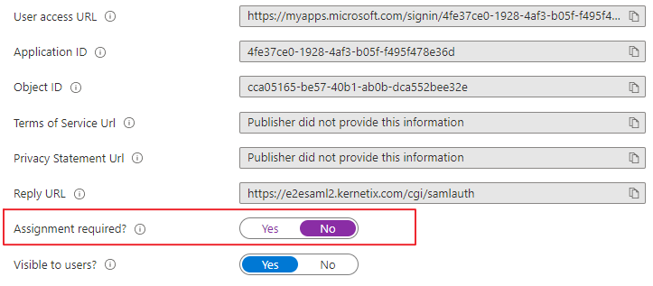
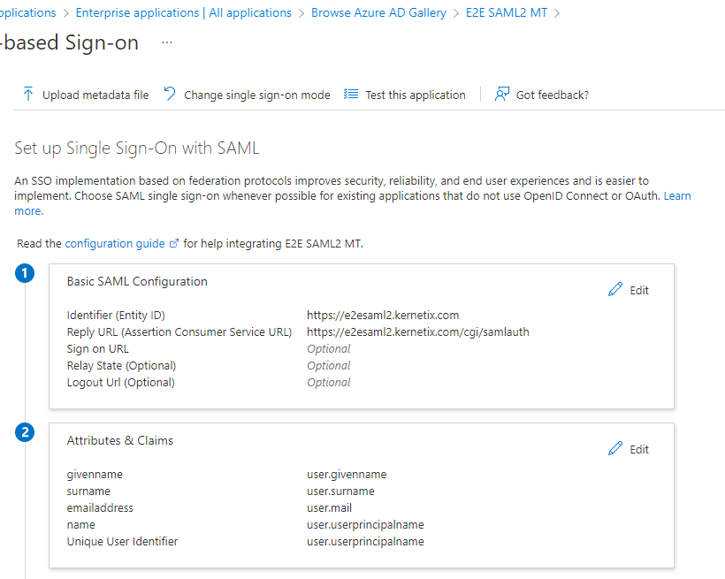
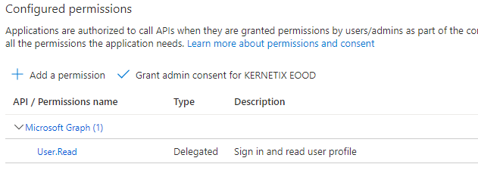
SAML 2.0 Multi-Tenant
2. Disable User Assignment Required.
1. Register a SAML Azure App with Logon Entity ID etc.
3. Enable Multi-Tenancy and add User.Read Permissions
4. SAML does not support Tenant-ID claim. But we can use the UPN.
Notes:
Same functionality could be accomplished via SAML2.
SAML protocol from Azure AD side includes in a different way the Tenant ID inside the SAML protocol.
We’ll be making the Authorization Based on user.userprinciplename plus Tenant ID. Because the user principal name could be easily manipulated value. And the claim is exchanged through the user agent, so the name of the claim is also easily compromised information.

Slide 43
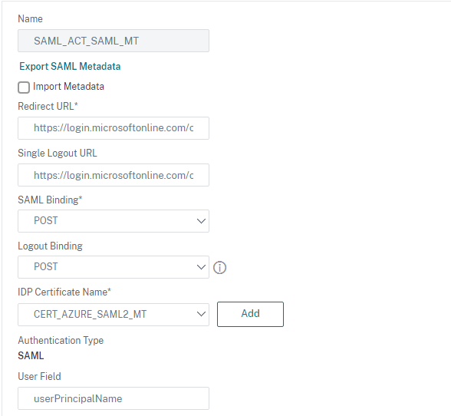
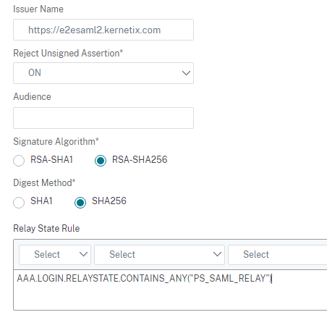
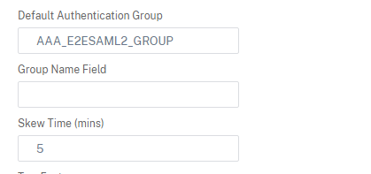
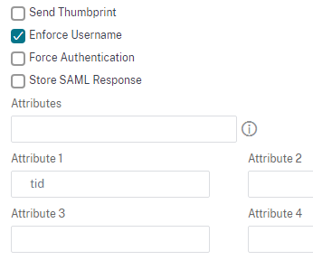
SAML 2.0 NetScaler Config
Single Tenant Redirect Url: | https://login.microsoftonline.com/7b027649-48a4-4b51-9fbb-f035395571ad/saml2
Multi-Tenant | https://login.microsoftonline.com/common/saml2
Metadata | https://login.microsoftonline.com/common/FederationMetadata/2007-06/FederationMetadata.xml
1. Populate Manually all the info. The Federation Metadata XML will contain Tenant Info. Use Redirect or Post for binding .
Notes:
Federation Metadata file is wrong on Azure AD side.
Real Metadata: https://login.microsoftonline.com/common/FederationMetadata/2007-06/FederationMetadata.xml
Export the certificate and import it into the NetScaler.
Due to multiple certificate present inside the metadata the NetScaler will not read it correctly. Do not use directly the metadate URL. Populate the info with the multi-tenant URL and use single certificate on the NetScaler.
Note: A Case has been submitted to Citrix for correcting the behavior with multi-tenant metadata URL.

Slide 44
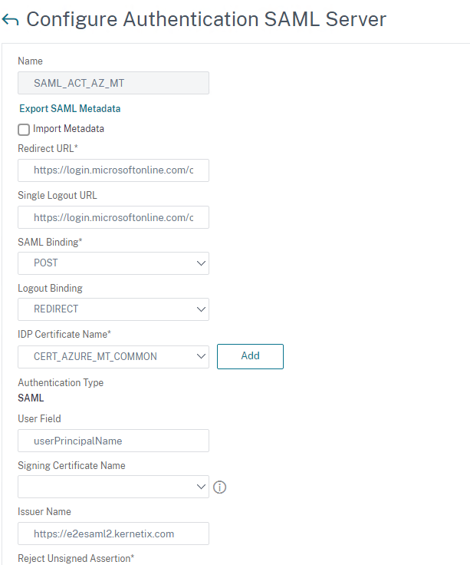
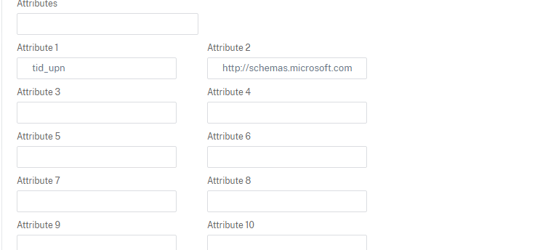
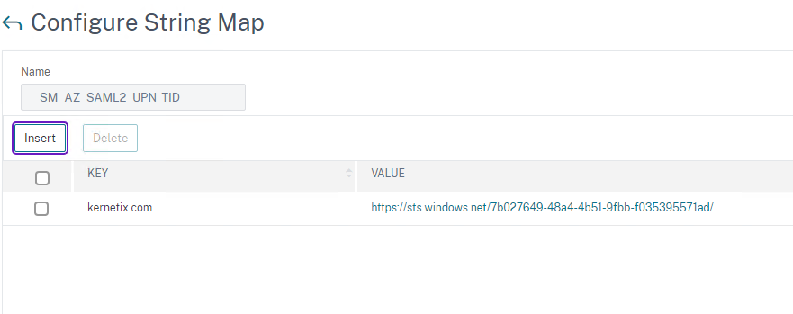
SAML 2.0 NetScaler Config
Notes:
Authorization for SAML2.
Inside the SAML Action – Configure the following two attributes:
tid_upn – this is custom claim corresponding to user.userprincipalname. You can use the default, if you wish.
http://schemas.microsoft.com/identity/claims/identityprovider – this is the claim that will show the Home Tenant ID.
We’re using string maps to extract the Tenant ID and make a match with the authorized domain.
Due to a bug inside the NetScaler I’m using custom policy extension for the expression:
add policy stringmap SM_AZ_SAML2_UPN_TID
bind policy stringmap SM_AZ_SAML2_UPN_TID kernetix.com "https://sts.windows.net/7b027649-48a4-4b51-9fbb-f035395571ad/"
add authorization policy AUTHORIZE_POL_AZ_UPN_TID "AAA.USER.ATTRIBUTE(1).AFTER_STR(\"@\").IS_STRINGMAP_KEY(\"SM_AZ_SAML2_UPN_TID\")&&AAA.USER.ATTRIBUTE(1).AFTER_STR(\"@\").MAP_STRING(\"SM_AZ_SAML2_UPN_TID\").CONTAINSEXPR(AAA.USER.ATTRIBUTE(2) ALT \"empty\")\n" ALLOW
bind aaa group AAA_E2ESAML2_GROUP -policy AUTHORIZE_POL_AZ_UPN_TID -priority 100 -gotoPriorityExpression END
Note: Because of Azure AD bug, Multi-tenant SAML2 Apps are using the Tenant certificate for signing the assertion for users members of the App hosting Tenant. All other users will use the certificates present in the Multi-tenant metadata URL. Host the App Registration in separate Tenant where no users will be accessing the app!

Slide 45
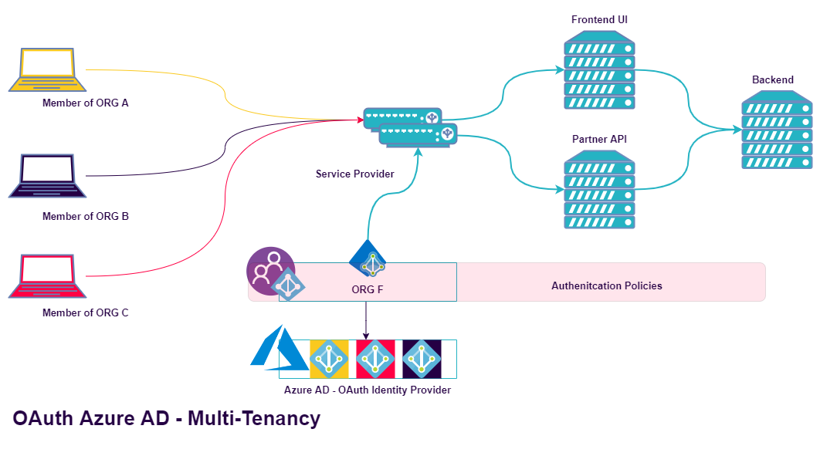
Authentication Policy Control
Notes:
As previously mentioned, the control over the Authentication Policies, MFA enforcement and Contextual Access stays at User’s Home Tenant (their Organization Tenant).
If that is not to your likeness and you want to control these policies create the Multi-Tenant application in a B2C Azure Tenant. Then you can enforce policies regardless of Home Tenant. An example is having a different MFA authentication only for your published application, while the Home Tenant will have MFA for everything else.

Slide 46
Thank you!
E-mail: akafedzhiev@positivethinking.tech

